Slide 1
Personal Website
Software Studio 軟體設計與實驗
Hung-Kuo Chu
Department of Computer Science
National Tsing Hua University
CS2410

Slide 2
Layout
What are we going to do?
TODO
Starting up
Bootstrap Components
Photo Gallery – Grid
YouTube <iframe> – Media Query
Grading Policy

Slide 3
What are we going to do?
Make a website from scratch
Make a responsive website (RWD)
Use Bootstrap components

Slide 4
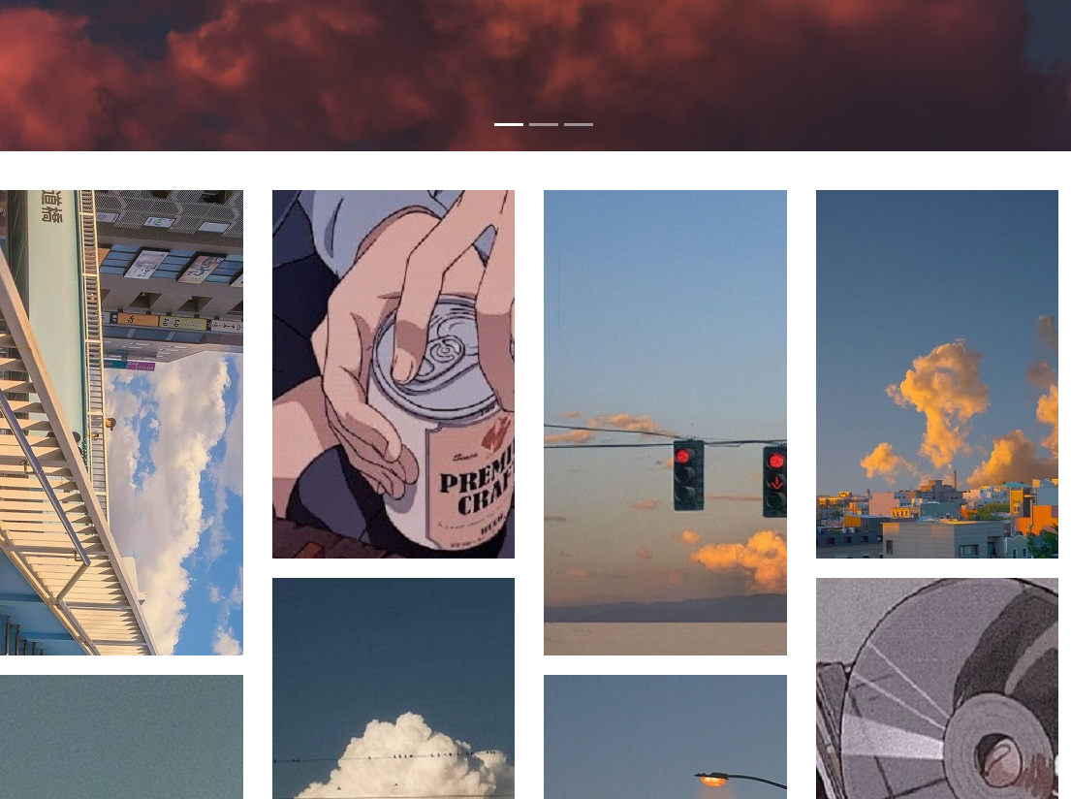
What are we going to do?
Checkout the Website!
https://107062213.gitlab.io/lab03-demo/

Slide 5
Goal
Add 3 Bootstrap components
Add a photo gallery
Add YouTube <iframe>

Slide 6
Goal
Remove fork relation and set project visibility to public.
Do not use any template from Internet or you will get zero grade
Deadline: 2022/03/01 17:20 (commit time)

Slide 7
Layout
What are we going to do?
TODO
Starting up
Bootstrap Components
Photo Gallery – Grid
YouTube <iframe> – Media Query
Grading Policy

Slide 8
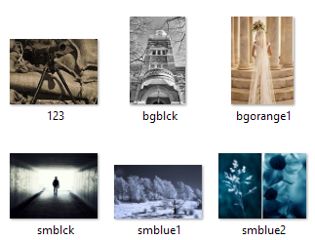
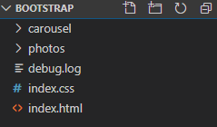
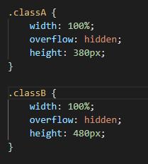
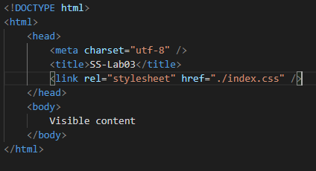
Starting up - Files
Link the css file to your html file

Slide 9
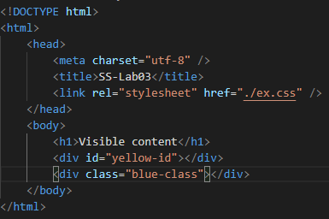
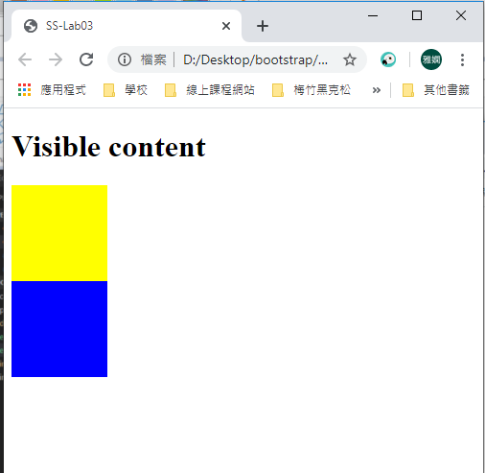
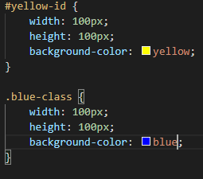
Starting up - CSS Class & Id
ex.html
ex.css
#id-name
.class-name

Slide 10
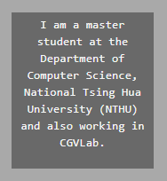
Starting up -The <div> Element
A <div> element is important to website layouts
<div> is often used with CSS style
When used with CSS, the <div> element can be used to style blocks of content

Slide 11
Layout
What are we going to do?
TODO
Starting up
Bootstrap Components
Photo Gallery – Grid
YouTube <iframe> – Media Query
Grading Policy

Slide 12
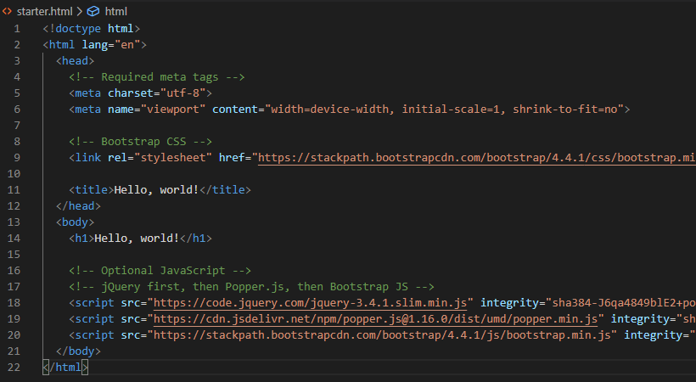
Bootstrap Component
Fork Bootstrap starter template from TA’s repo!

Slide 13
Bootstrap Component
Let’s start building our website!
Bootstrap is an extremely popular front-end framework for building responsive website, providing us with a bunch of front-end components.
Let us try adding a navbar to our website.

Slide 14
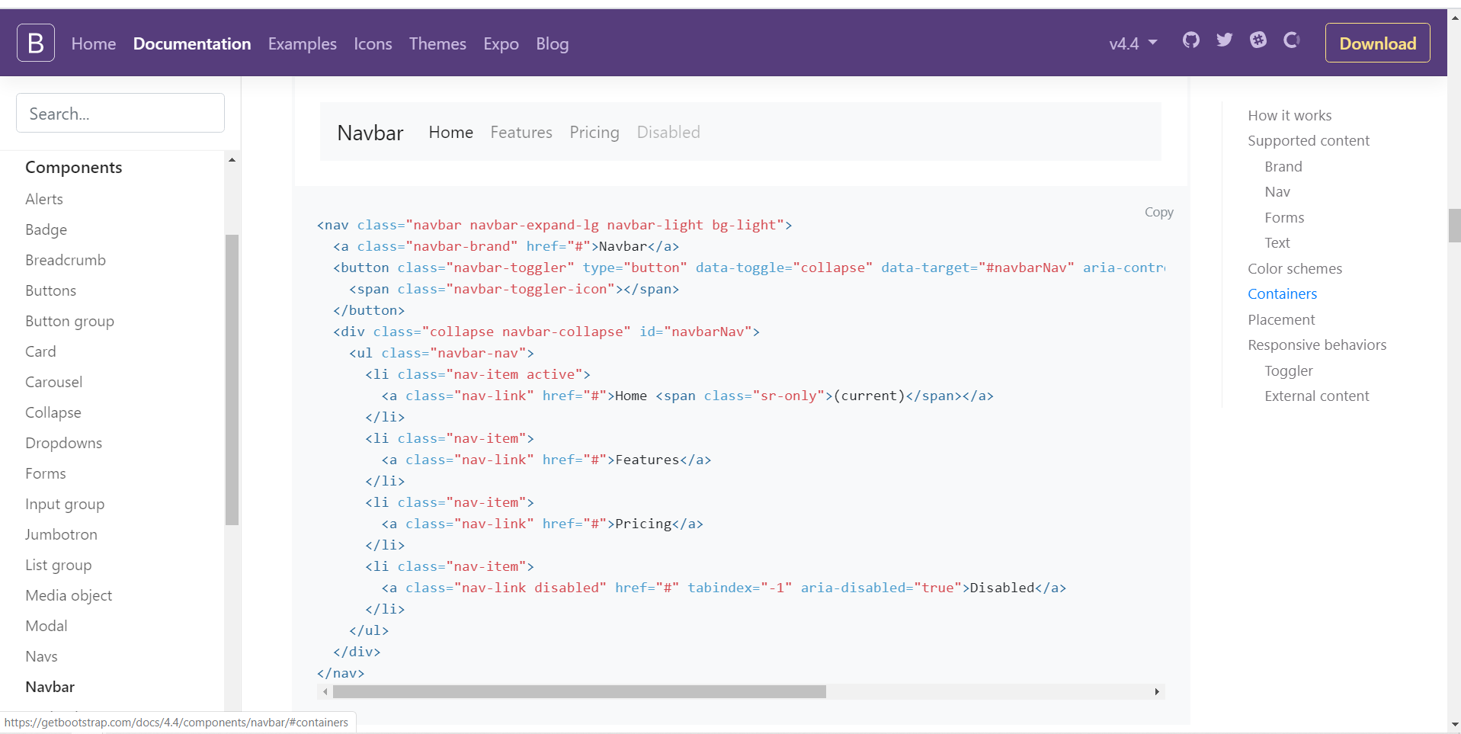
Bootstrap Component
Bootstrap Documentation - navbar
Copy the code!

Slide 15
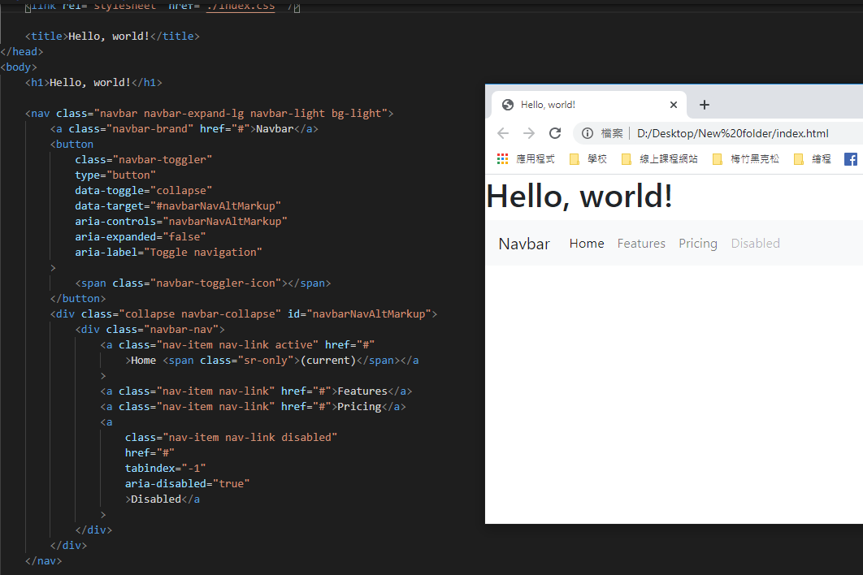
Bootstrap Component
Paste the code
Navbar is added!

Slide 16
Bootstrap Component
Choose 3 Bootstrap components from below and add them to your website!
Button
Card
Carousel
Media object
Modal
Dropdown
Jumbotron
Collapse

Slide 17
Bootstrap Component
Modify the components to fit your website!
You can:
Change the style of the component (different size, font, color, etc.)
Change the href attribute (point to another website, or another element in the same page)
Change the options attributes shown in the Bootstrap documentation (ex: “data-interval” for Carousels)
No points if you only change the text content.
Make it obvious!

Slide 18
Layout
What are we going to do?
TODO
Starting up
Bootstrap Components
Photo Gallery – Grid
YouTube <iframe> – Media Query
Grading Policy

Slide 19
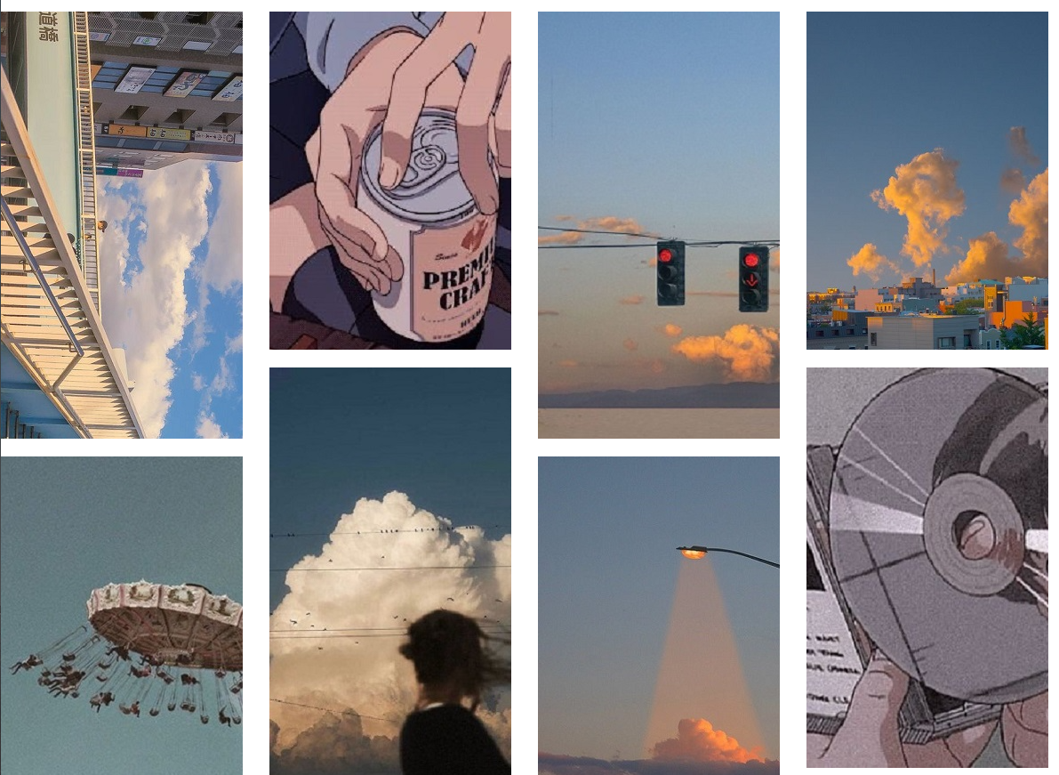
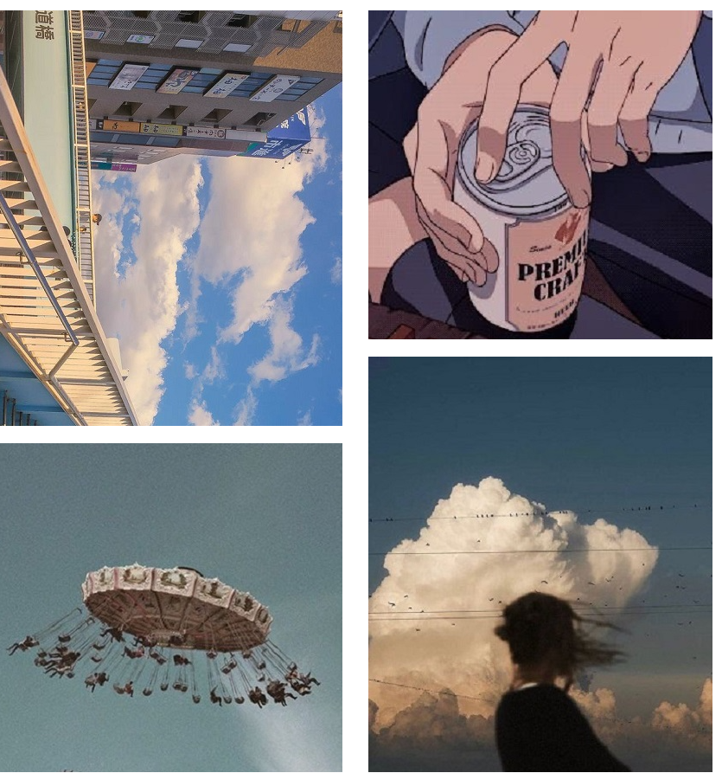
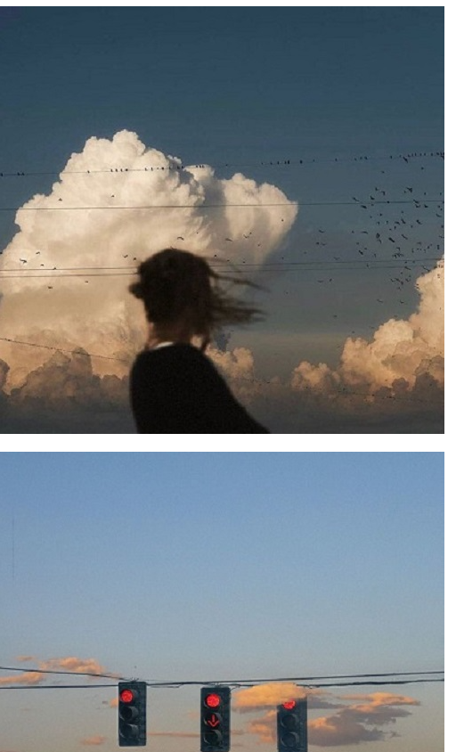
Photo Gallery – Grid
width: 1200px
width: 900px
width: 650px

Slide 20
Photo Gallery – Grid
Divide the page into columns with Grid.
12
col-lg-3
When the screen is ‘large’, we divide the gallery into 4 columns.
3
3
3
3
Grid Tutorial
https://getbootstrap.com/docs/4.4/layout/grid/

Slide 21
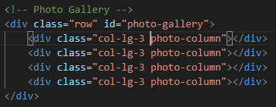
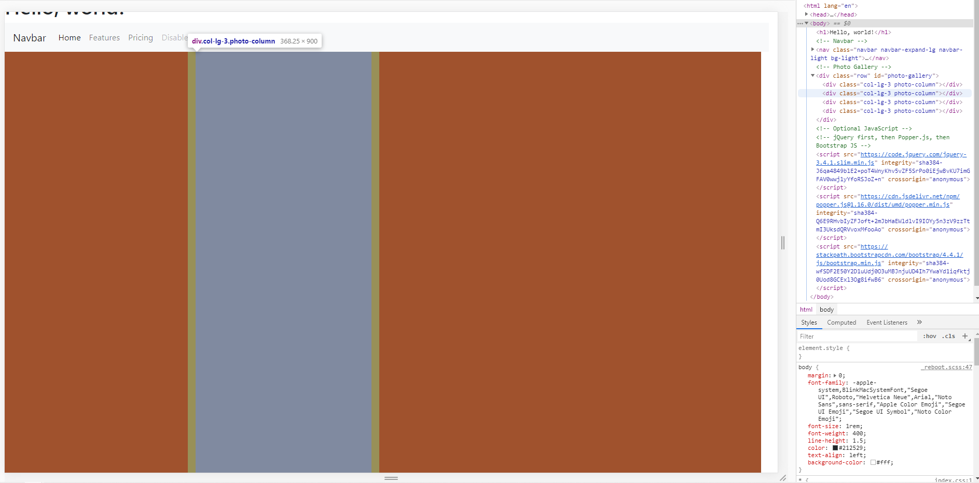
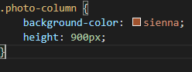
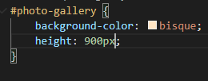
Photo Gallery – Grid
Divide a <div> into four columns.
Index.html
Bootstrap class
Index.css

Slide 22
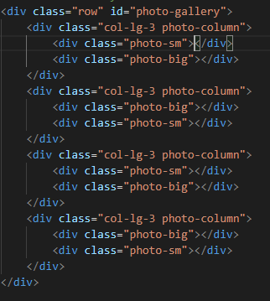
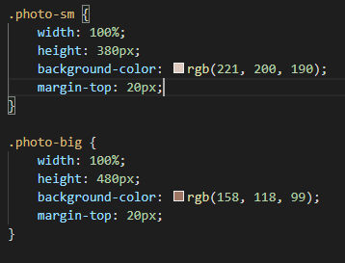
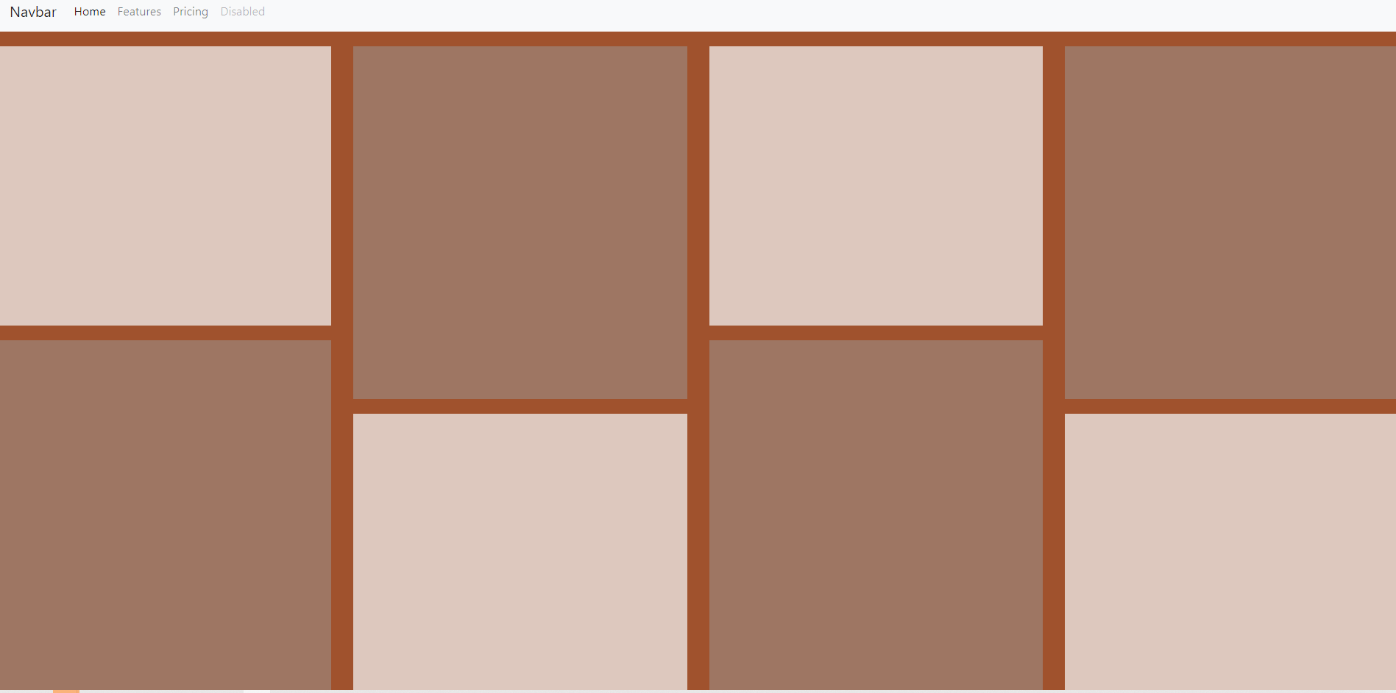
Photo Gallery – Grid
Divide each columns to 2 parts.
Index.html
Index.css

Slide 23
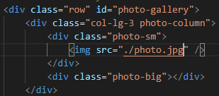
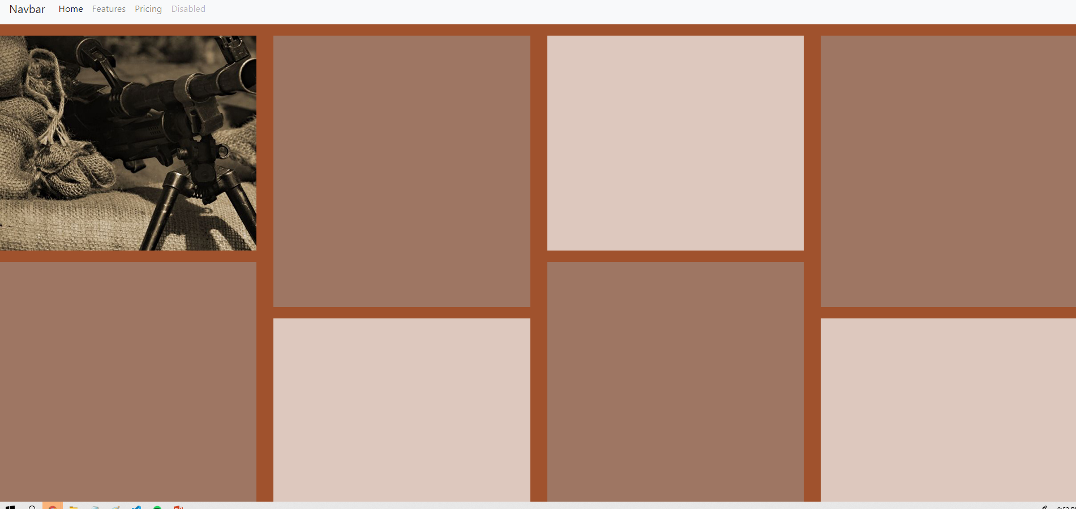
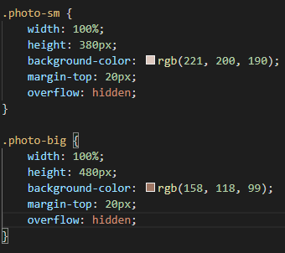
Photo Gallery – Grid
Add an image.
Index.html
Index.css
If not added, the photo will overflow the border

Slide 24
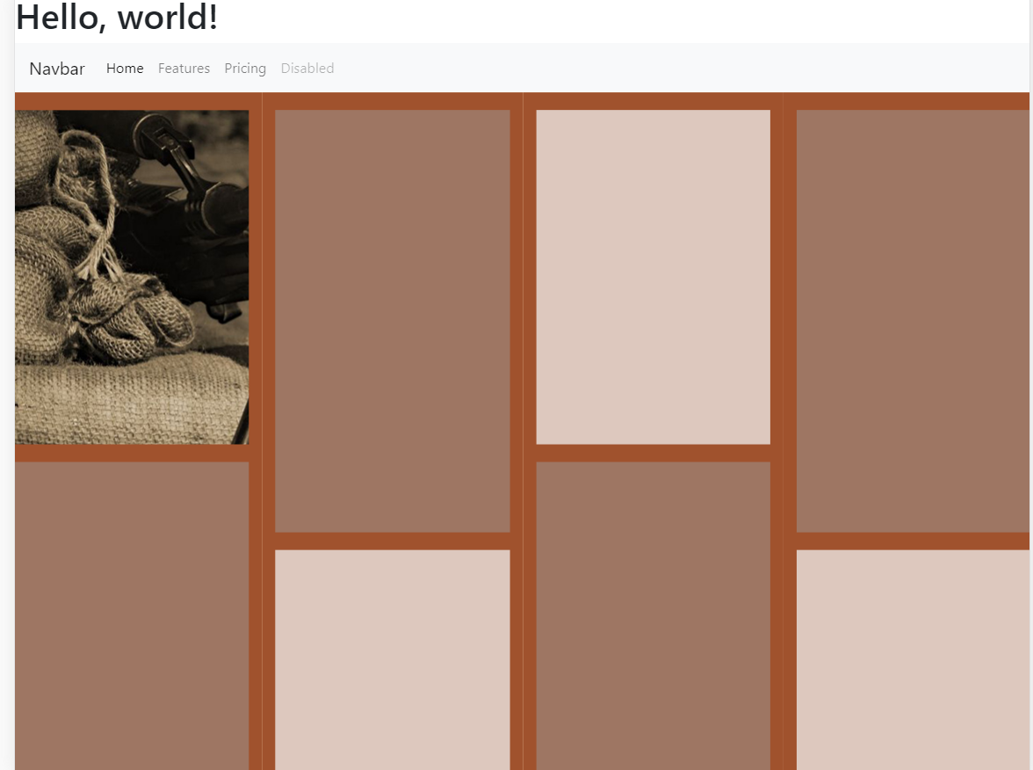
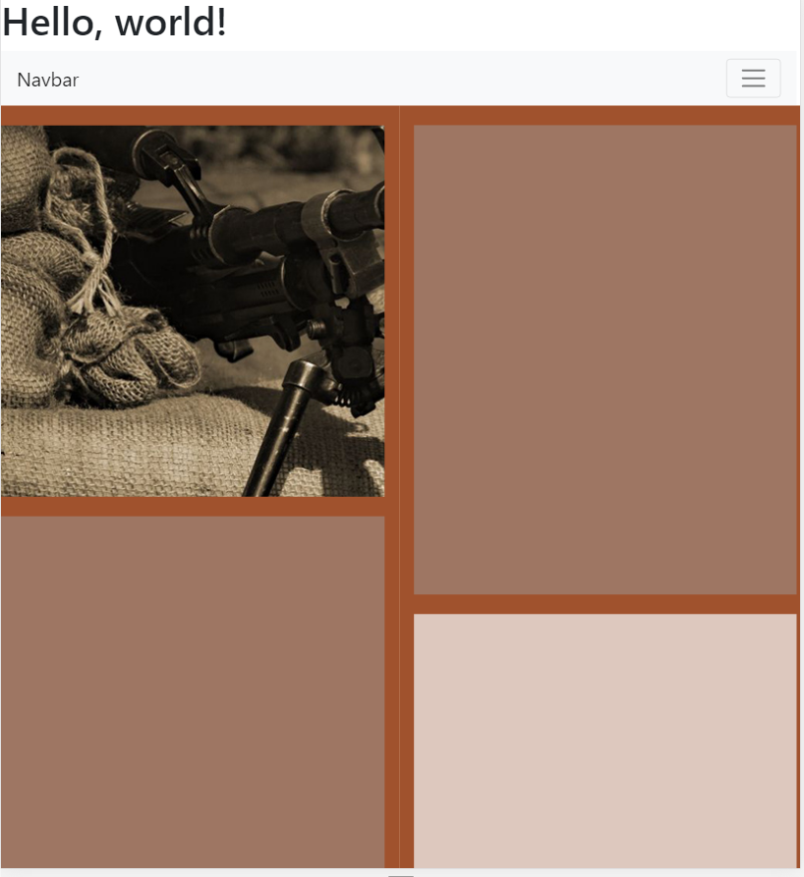
Photo Gallery – Grid
The gallery becomes single-columned if the screen width is smaller than 911px(large screen size).
Can we make it 2-columned?
?

Slide 25
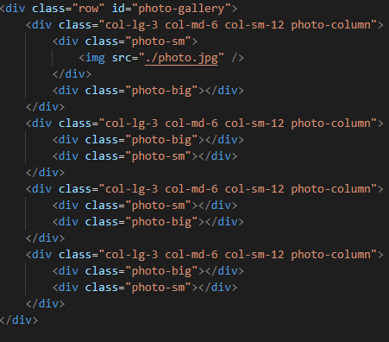
Photo Gallery – Grid
Add col-md-6 and col-sm-12

Slide 26
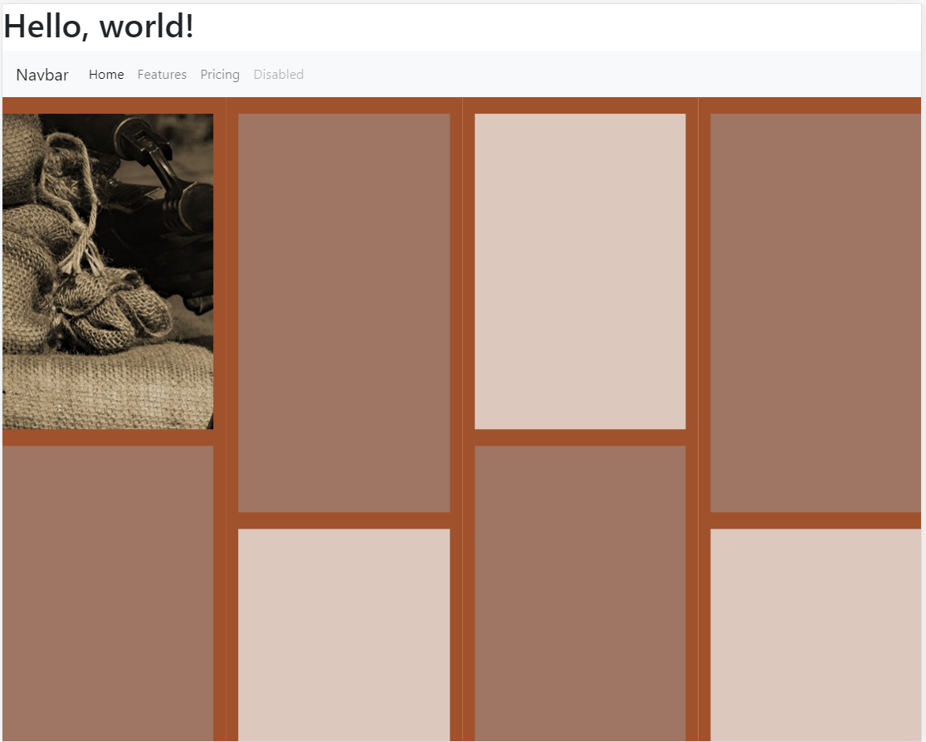
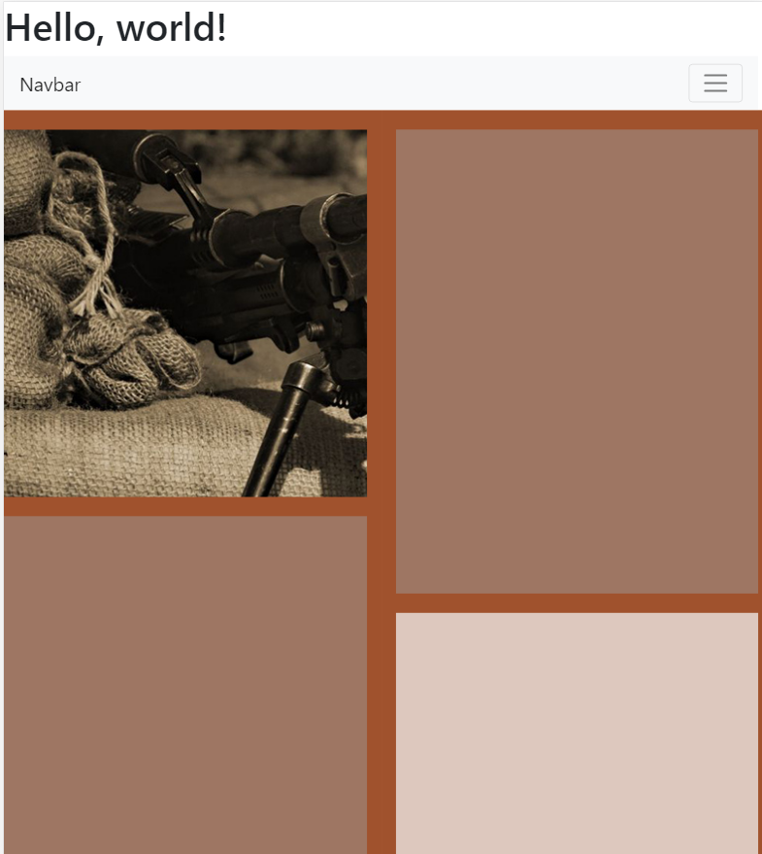

Photo Gallery - Grid
Now we get a responsive webpage!

Slide 27
Photo Gallery - Grid
Also, it is strongly recommended to learn Flex system, which is another layout system.
Flexbox Froggy:
https://flexboxfroggy.com/

Slide 28
Layout
What are we going to do?
TODO
Starting up
Bootstrap Components
Photo Gallery – Grid
YouTube <iframe> – Media Query
Deploy Websites with Gitlab
Grading Policy

Slide 29
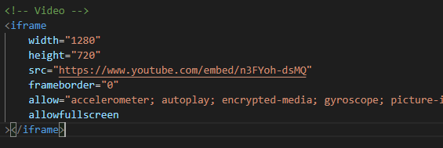
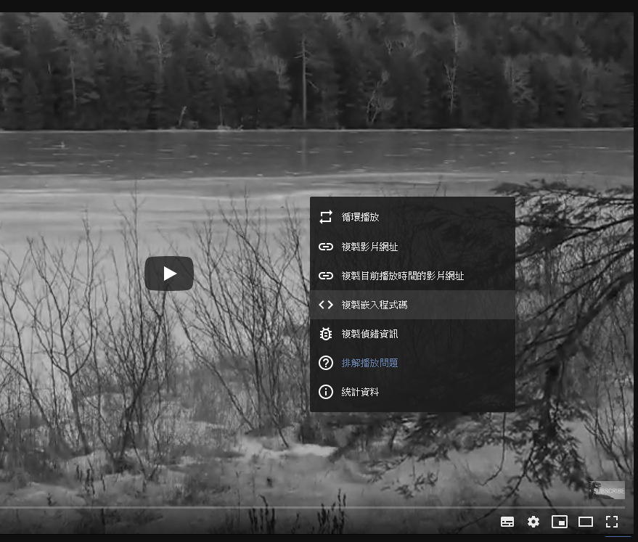
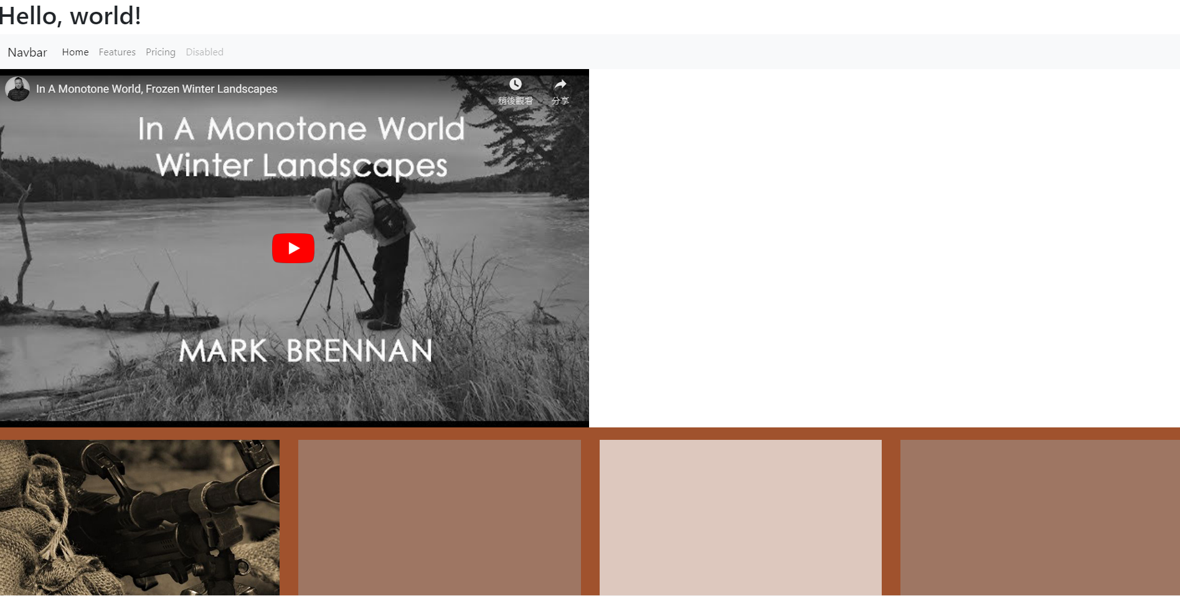
YouTube <iframe> – Media Query
Adding a YouTube video to our webpage is extremely easy!

Slide 30

YouTube <iframe> – Media Query
But how do we make it responsive?
The left part of the video is hidden ☹

Slide 31
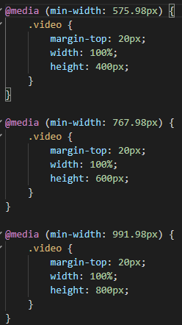
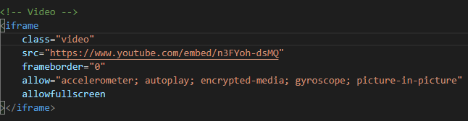
YouTube <iframe> – Media Query
But how do we make it responsive?
Index.css
Index.html
Remove ‘width’ & ‘height’, add ‘class’

Slide 32

YouTube <iframe> – Media Query
Now it works perfectly!
Try to add a responsive YouTube video to your page!

Slide 33
Layout
What are we going to do?
TODO
Starting up
Bootstrap Components
Photo Gallery – Grid
YouTube <iframe> – Media Query
Deploy Websites with Gitlab
Grading Policy

Slide 34
Grading Policy
4 Bootstrap Components (5% x4)
Customize components (5% x4)
Photo Gallery
At least one photo 5%
Basic Layout 20%
RWD Layout (3 layouts) 5%
YouTube <iframe>
<iframe> 5%
Responsive with media query 25%

Slide 35
Bootstrap Components
Button
Card
Carousel
Media object
Modal
Dropdown
Jumbotron
Collapse

